Slide 1

TestNG

Slide 2
Introduction
TestNG is a testing framework for the Java programming language inspired from JUnit .
The "NG" means "Next Generation."
The design goal of TestNG is to cover a wider range of test categories like unit, functional, end-to-end, integration etc, with more powerful and easy-to-use functionalities.

Slide 3
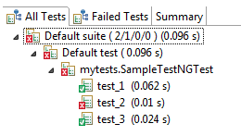
Need of TestNG
TestNG can generate reports based on our Selenium test results.
TestNG can generate the report in a readable format.

Slide 4
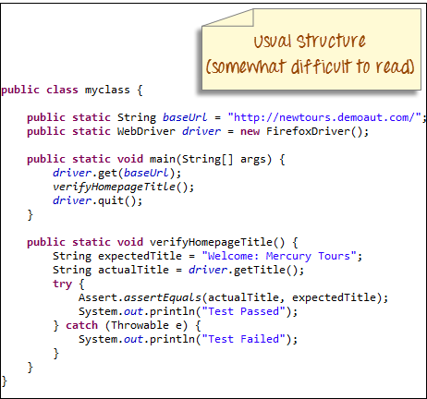
The sequence of actions is regulated by easy-to-understand annotations that do not require methods to be static.
Uncaught exceptions are automatically handled by TestNG without terminating the test prematurely. These exceptions are reported as failed steps in the report.

Slide 5
Benefits of TestNG
The major advantages of TestNG are :-
It gives the ability to produce HTML Reports of execution
Annotations are easier to understand
Test cases can be Grouped & Prioritized more easily
Parallel testing is possible
Generates Logs
Data Parameterization is possible

Slide 6
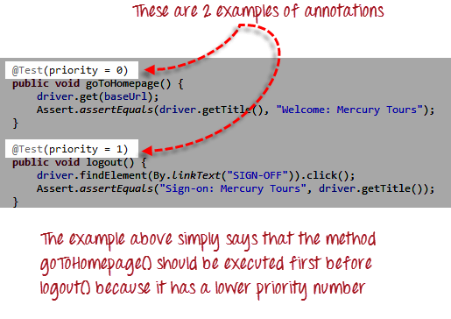
Annotations
Annotations in TestNG are lines of code that can control how the method below them will be executed.
They are always preceded by the @ symbol.

Slide 7
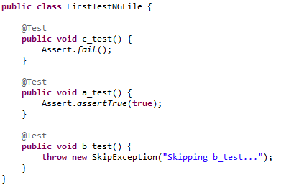
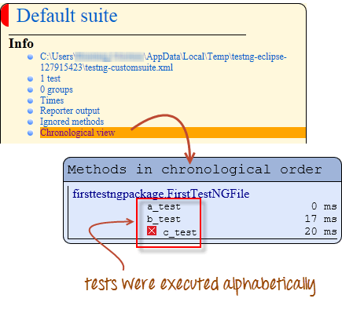
Multiple Test Cases
Use multiple @Test annotations in a single TestNG file.
By default, methods annotated by @Test are executed alphabetically.
Run this code and on the generated index.html page, click "Chronological view."

Slide 8
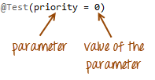
Parameters
Parameters are keywords that modify the annotation's function.
Parameters require you to assign a value to them. This can be by placing a "=" next to them, and then followed by the value.
Parameters are enclosed in a pair of parentheses which are placed right after the annotation.
If you want the methods to be executed in a different order, use the parameter "priority".
TestNG will execute the @Test annotation with the lowest priority value up to the largest.
Multiple Parameters use two or more parameters in a single annotation, separate them with a comma. Such as @Test(priority=0, enabled= True)

Slide 9
TestNG Annotations
Annotations | Description
@BeforeSuite | The annotated method will be run before all tests in this suite have run.
@AfterSuite | The annotated method will be run after all tests in this suite have run.
@BeforeTest | The annotated method will be run before any test method belonging to the classes inside the tag is run.
@AfterTest | The annotated method will be run after all the test methods belonging to the classes inside the tag have run.
@Test | The annotated method is a part of a test case

Slide 10
Annotations | Description
@BeforeGroups | The list of groups that this configuration method will run before. This method is guaranteed to run shortly before the first test method that belongs to any of these groups is invoked.
@AfterGroups | The list of groups that this configuration method will run after. This method is guaranteed to run shortly after the last test method that belongs to any of these groups is invoked.
@BeforeClass: | The annotated method will be run before the first test method in the current class is invoked.
@AfterClass | The annotated method will be run after all the test methods in the current class have been run.
@BeforeMethod | The annotated method will be run before each test method.
@AfterMethod | The annotated method will be run after each test method.

Slide 11
Benefits of using Annotations
It identifies the methods it is interested in by looking up annotations. Hence method names are not restricted to any pattern or format.
We can pass additional parameters to annotations.
Annotations are strongly typed, so the compiler will flag any mistakes right away.
Test classes no longer need to extend anything.

Slide 12
Covered Till Now
TestNG is a testing framework for the Java programming language inspired from JUnit .
Needs of TestNG.
Annotations in TestNG are lines of code that can control how the method below them will be executed.
Multiple Test cases use multiple @Test annotations in a single TestNG file.
Parameters are keywords that modify the annotation's function.
Multiple Parameters use two or more parameters in a single annotation, separate them with a comma.
Benefits of TestNG and their annotation.

Slide 13
Thanks

